Slide 1
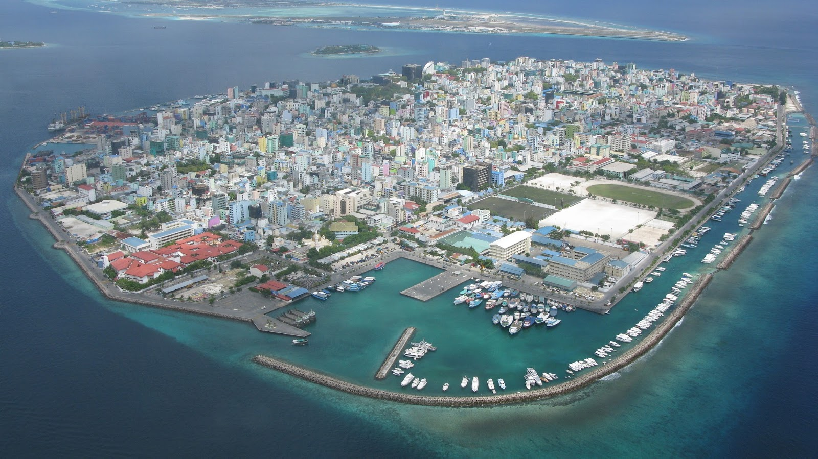
Global Climate Change
“We warn you that unless you act quickly and decisively, our homeland and others like it will disappear beneath the rising sea before the end of this century.”
- Mohamed Nasheed, former president of the Maldives

Slide 2
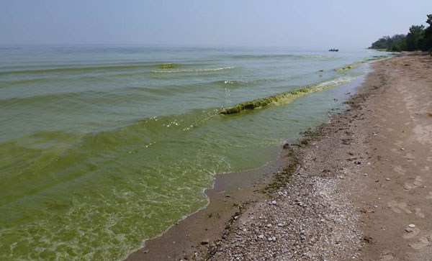
The Precambrian Period
During the Precambrian Period, from 4.6 billion to 540 million years ago, the Earth’s atmosphere was much different – it was mostly carbon dioxide and nitrogen.
A new life form evolved, called cyanobacteria.
Cyanobacteria have the ability to perform photosynthesis, absorbing carbon dioxide and releasing oxygen.
Cyanobacteria bloom, Lake Erie. Photo by Thomas Archer

Slide 3
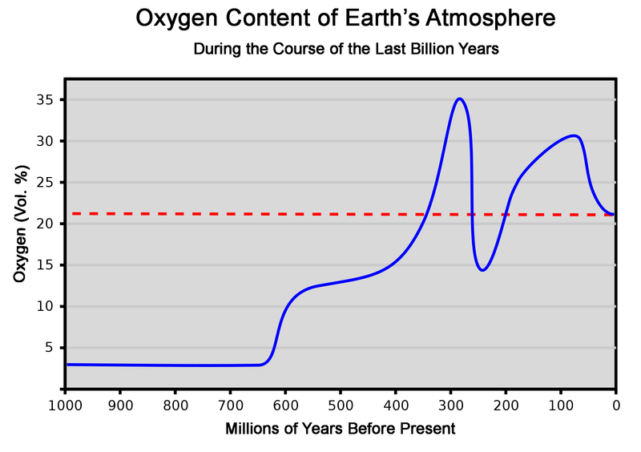
The influx of oxygen from the seas created an ecological crisis, as it poisoned many of the other species of bacteria.

Slide 4
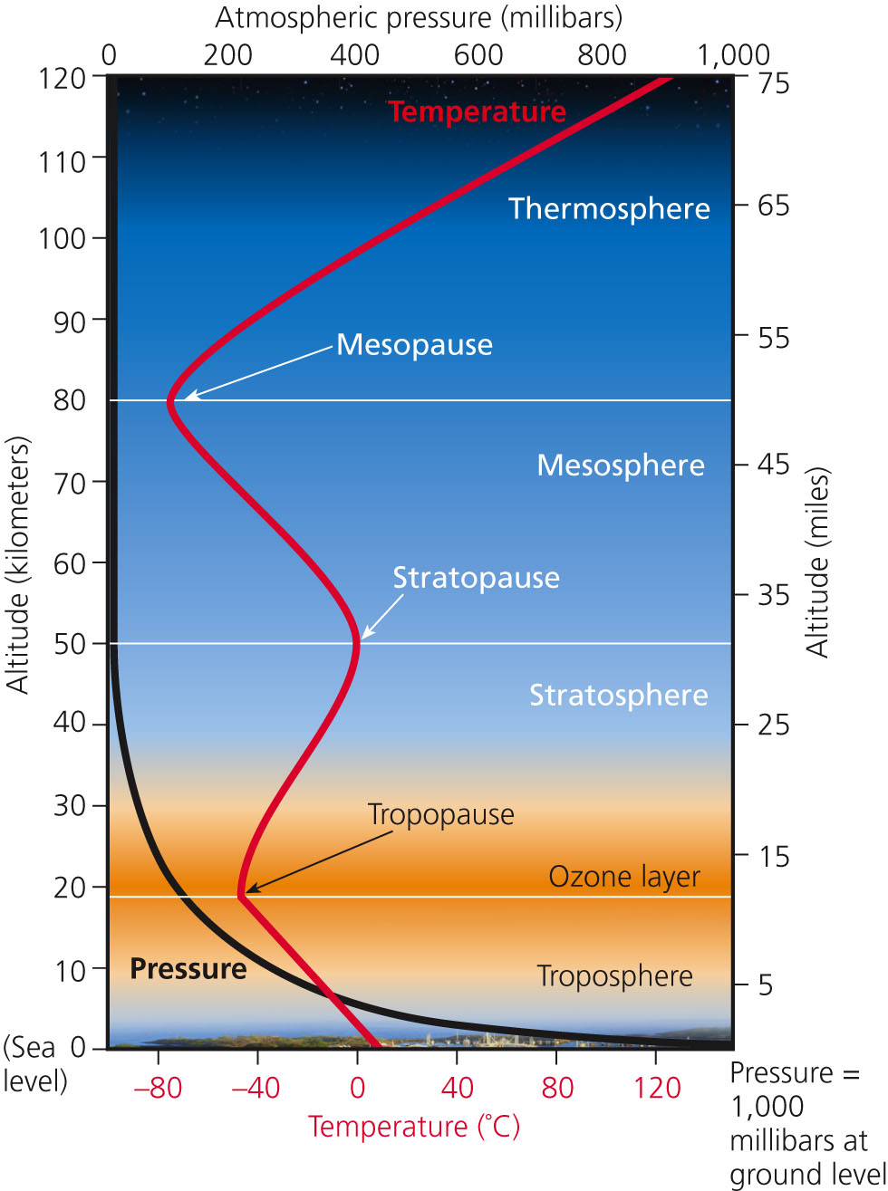
The Atmosphere
The atmosphere is a thin layer of gases that surrounds the earth.
The bottom layer, the troposphere, contains the air we breathe and every aspect of what we call weather.

Slide 5
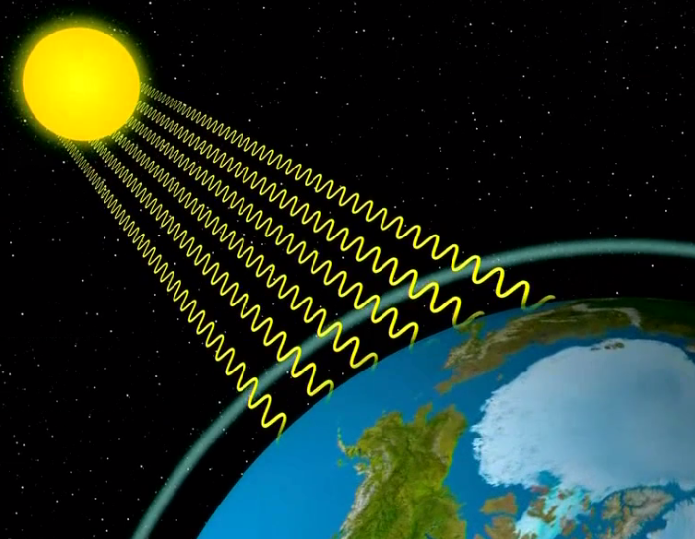
Some of the infrared energy from the sun penetrates the atmosphere, warming the Earth’s surface.

Slide 6
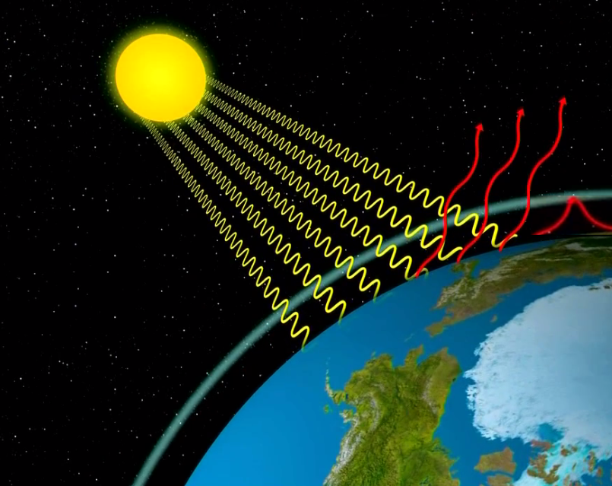
The infrared energy is then re-radiated off the Earth’s surface, back towards space.
Some of that energy is kept at the surface by the troposphere.

Slide 7
Greenhouse Effect
The trapping of some of the infrared radiation within the atmosphere keeps the Earth’s daily temperature fluctuations within a small, habitable range.
This is called the greenhouse effect.
The greenhouse gases responsible for this effect include:
Chloroflurocarbons (CFCs)
Nitrous oxide
Methane
Carbon dioxide
Water vapor

Slide 8
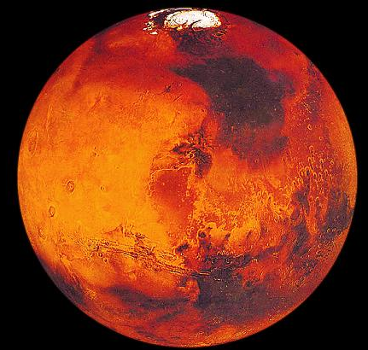
Mars, a sister planet to the Earth, has a much thinner atmosphere and no significant greenhouse effect.
A Martian summer daytime high near the equator may approach 70°F.
At night, the same location would experience a low of -100°F.

Slide 9
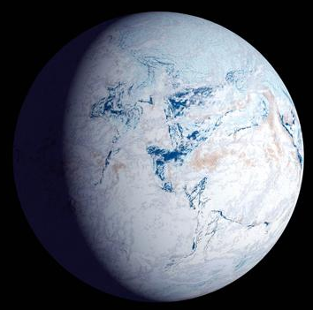
Cyanobacteria photosynthesis absorbed a lot of carbon dioxide.
Oxygen released during the Precambrian period had the added effect of decreasing the concentration of methane.
This event, called the oxygen catastrophe, led to one of the greatest and longest ice ages.
The “snowball Earth hypothesis” suggests the planet was mostly covered in ice.

Slide 10
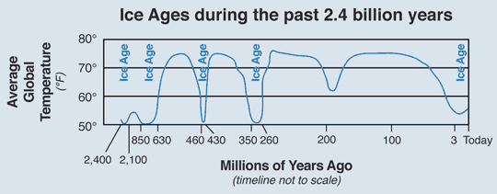
Ice Ages
An ice age is a period of time where the Earth’s overall surface temperature is lowered enough that glaciers form at the poles and in mountainous areas.
The Earth has experienced at least 5 major ice ages.

Slide 11
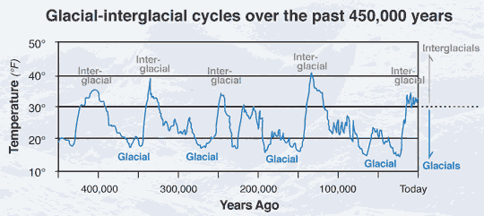
Within each ice age, glaciers will expand and shrink.
During glacial periods, glaciers are growing and advancing.
During interglacial periods, the overall climate is warmer, leading the glaciers to retreat.
We are currently in an interglacial period of an ice age.

Slide 12
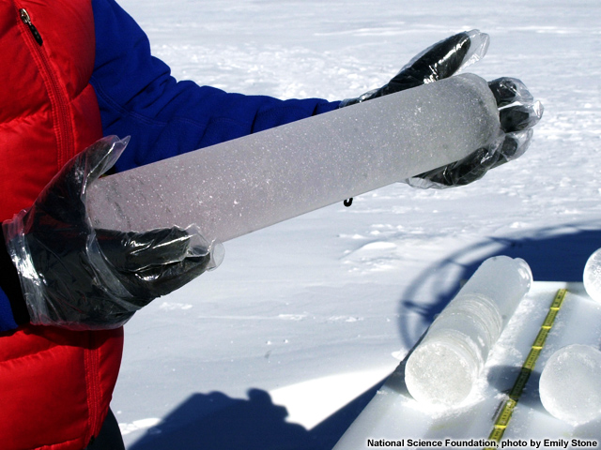
Proxies
Temperature data prior to the 19th century is the result of proxies, or indirect measurements.
Ice cores are drilled into the glaciers in Antarctica and Greenland.
Dissolved bubbles of atmosphere in each layer are analyzed.

Slide 13
Eyes of Nye, Global Climate Change, 2005.

Slide 14
Two gases are analyzed in each ice core layer.
Relative amounts of two isotopes of oxygen can be used to estimate the temperature at the time the ice was formed.
Concentration of greenhouse gases, like carbon dioxide and methane, are measured directly.
These measurements have been used to create graphs showing atmospheric changes during the lifespan of the glaciers.

Slide 15
Comparing the graphs shows a correlation between carbon dioxide and methane levels and surface temperature.

Slide 16
Comparing the graphs shows a correlation between carbon dioxide and methane levels and surface temperature.

Slide 17
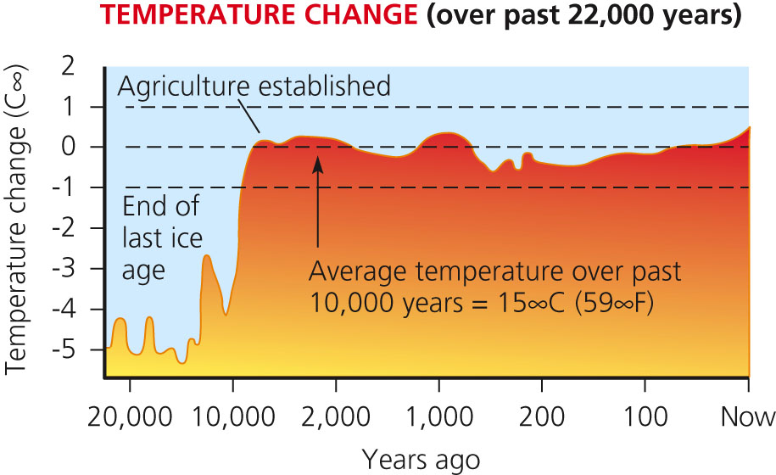
The last glacial period on Earth ended about 10,000 years ago.
This coincides with the beginnings of plant and animal agriculture.

Slide 18
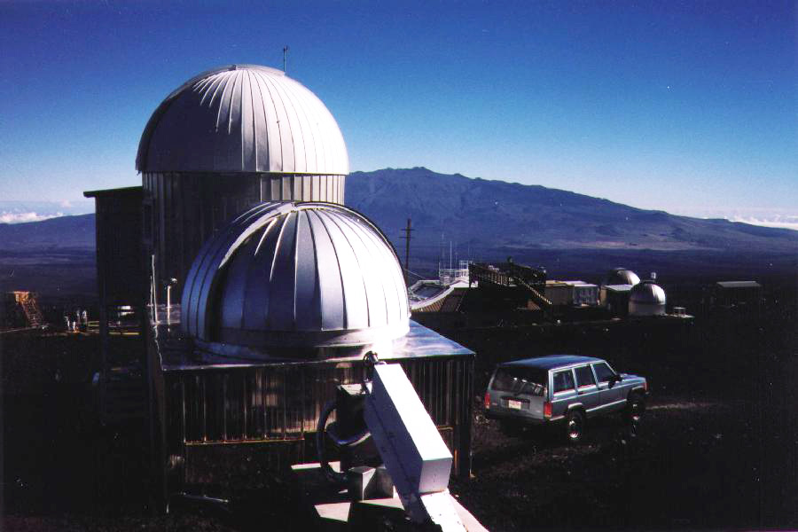
Tracking Global Climate Change
In 1958, measurements of atmospheric carbon dioxide levels were directly sampled at an observatory in Mauna Loa, Hawaii.
Hawaii was chosen to avoid the influences of large forests or cities.

Slide 19
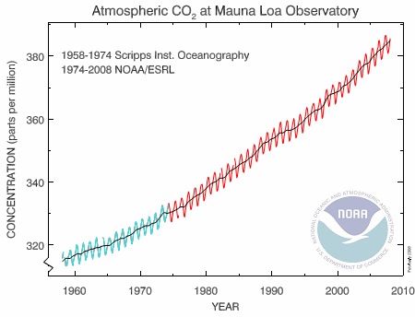
Carbon dioxide levels fluctuate within each year, depending on the season of the Northern Hemisphere.
Slightly higher CO2 in the winter.
Slightly lower CO2 in the summer.
Overall trend shows a steady increase.

Slide 20
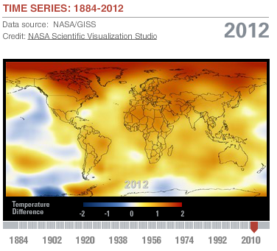
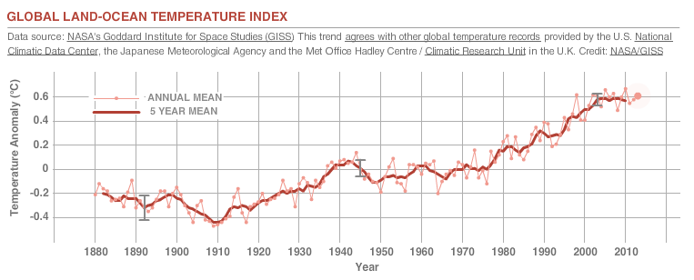
Both land and ocean surface temperatures have increased since the industrial revolution.
0.76°C increase in air temperature since 1850.
Current rate of 0.13°C per decade.
Source: Climate Change Key Indicators climate.nasa.gov/key_indicators

Slide 21
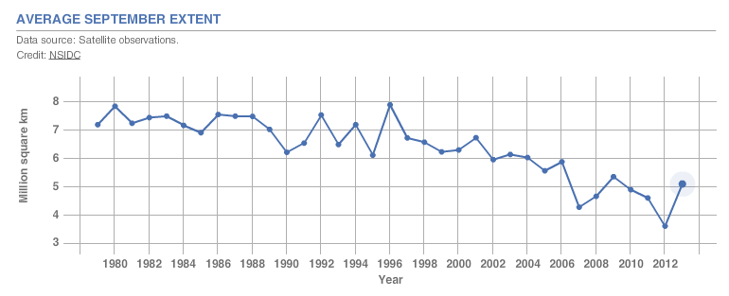
Sea ice is frozen seawater that floats on the ocean’s surface.
The Arctic reaches its minimum sea ice extent each September, at the end of summer.
September Arctic sea ice extent is declining at a rate of 11.5% per decade.
Source: Climate Change Key Indicators climate.nasa.gov/key_indicators

Slide 22
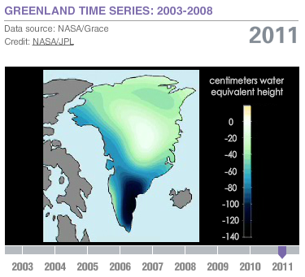
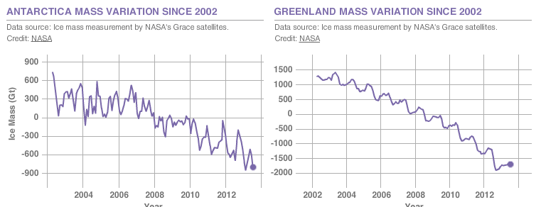
Land ice includes glaciers, ice sheets, ice caps, and permafrost.
Currently losing 24 cubic miles of ice per year in Antarctica.
Source: Climate Change Key Indicators climate.nasa.gov/key_indicators

Slide 23
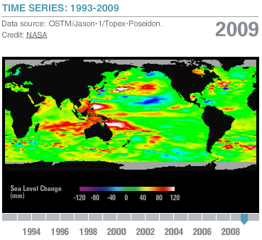
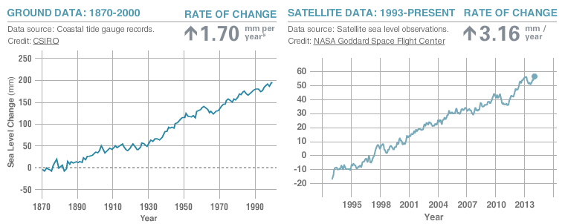
Sea level worldwide is increasing, primarily due to two factors.
Inflow of water from melting land ice.
Thermal expansion, or the increase in volume of water as it warms.
Source: Climate Change Key Indicators climate.nasa.gov/key_indicators

Slide 24
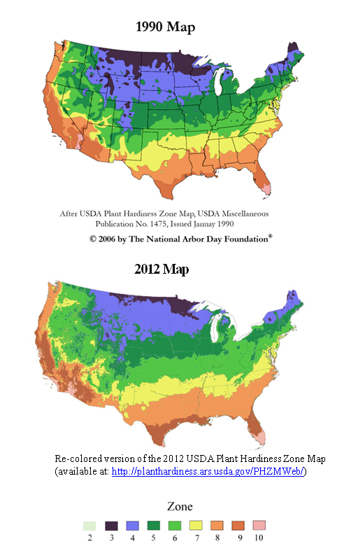
Impacts of Climate Change
The increase in surface temperature has altered growing seasons.
In 2012, the USDA released a new plant hardiness zone map with significant differences from the 1990 version.

Slide 25
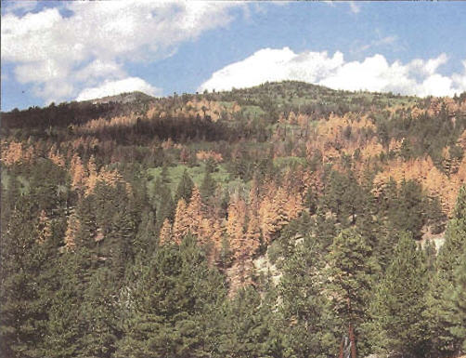
Warmer temperatures have increased the range of many pest insects.
Mosquitoes that spread diseases like malaria and West Nile Virus have expanded ranges.
Pine bark beetles have begun infesting boreal forests east of the Rocky Mountains.
Historically, these forests would have been too cold and out of their range.
Dixie National Forest, Utah, United States.

Slide 26
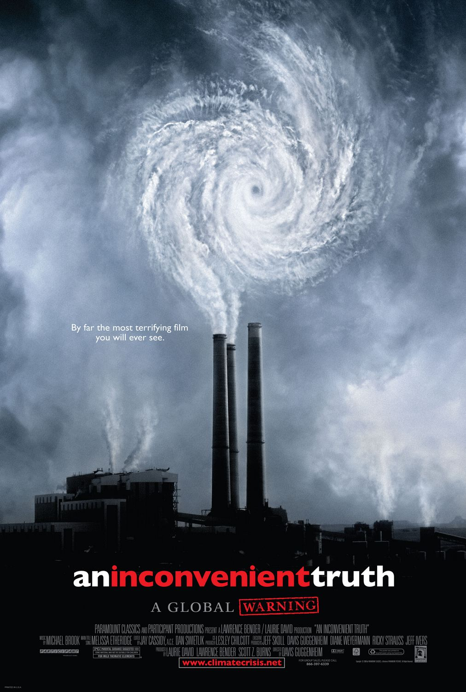
Hurricanes
No significant link has been found between global warming and hurricane frequency.
It is likely that hurricanes will increase in intensity by 2-11% by the end of the 21st century.
Promotional poster for An Inconvenient Truth, 2006.

Slide 27
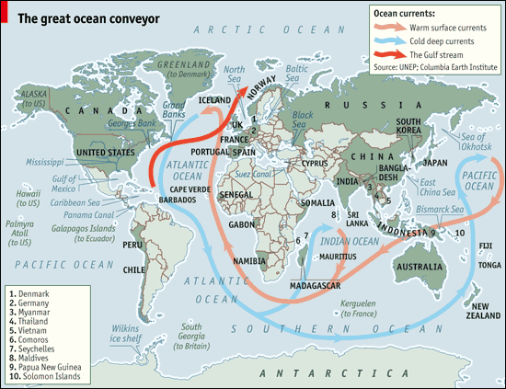
Great Ocean Conveyor
The Great Ocean Conveyor Belt is an underwater current fueled by the mixing of warm and cold salt water.
An influx of cold freshwater from melting land ice could disrupt this flow.

Slide 28
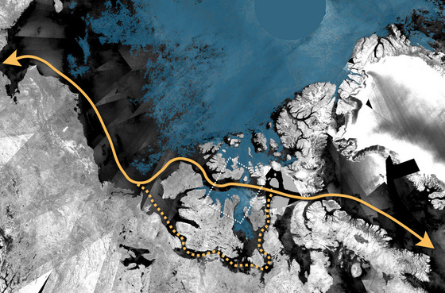
The Arctic
According to the IPCC 2013 report,
“Warming in the Arctic, as indicated by daily maximum and minimum temperatures, has been as great as in any other part of the world.”
In 2007, the September minimum extent of sea ice was low enough to open up the Northwest Passage.
The Arctic will likely experience an ice-free summer sometime this century.

Slide 29
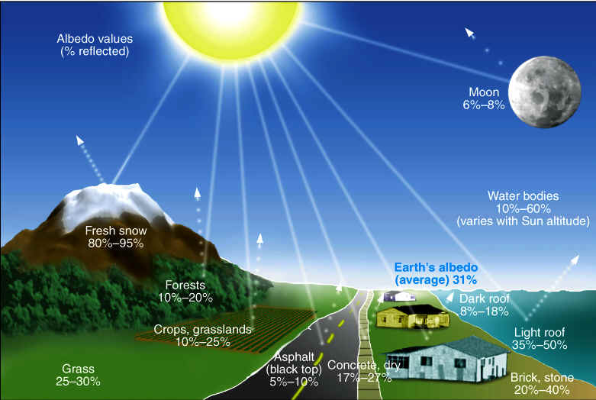
One of the reasons why the Arctic is heating so much faster is the difference in albedo between snow and ocean water.
Albedo is a measurement of how reflective a surface is.
Ocean water has a much lower albedo, so more heat is absorbed as the ice melts.

Slide 30
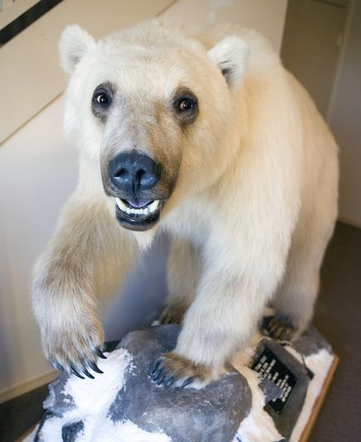
Polar bears are highly dependent on sea ice to hunt seals, their primary food source.
With sea ice in decline, the polar bear population is expected to decline by two-thirds by 2050.
Whether they go extinct depends on their ability to adapt to finding terrestrial food sources.
A “pizzly” or “grolar bear” hybrid caught by a hunter in Canada’s Northwest Territories in 2007.

Slide 31
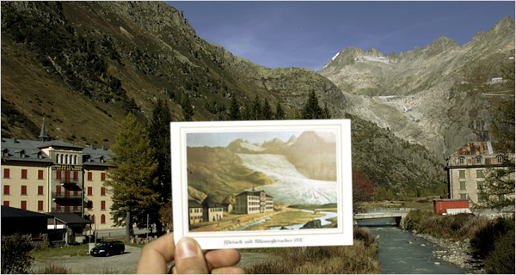
Temperate Glaciers
Only about 1% of the world’s land ice is located in temperate, or non-polar regions.
Mostly within mountain ranges.
A 1870 postcard of the Rhone glacier in Switzerland contrasted with a 2006 view.
Source: New York Times

Slide 32
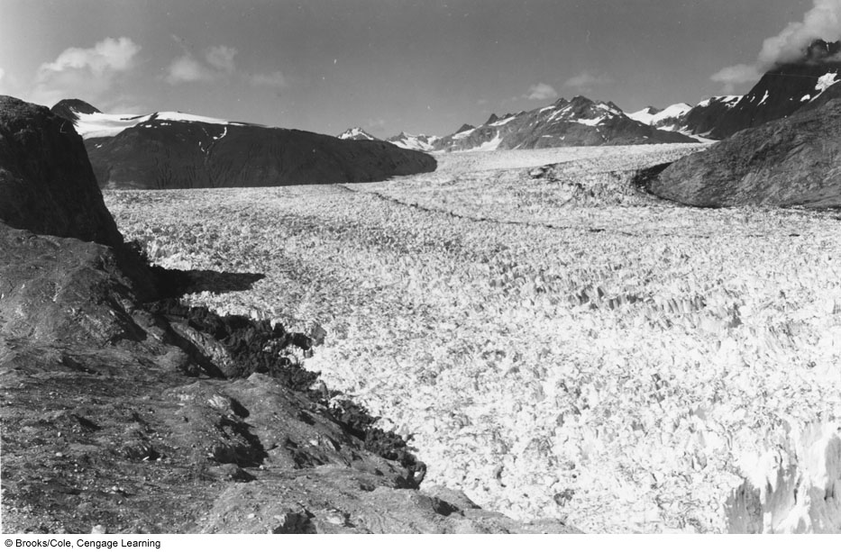
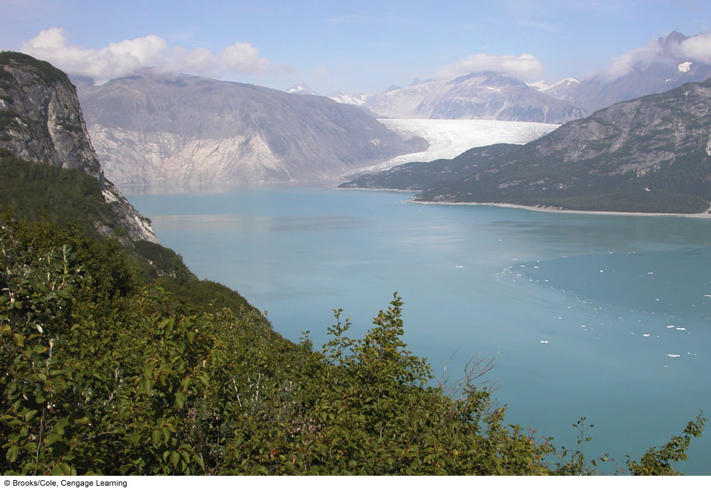
Melting of Alaska’s Muir Glacier between 1948 and 2004

Slide 33
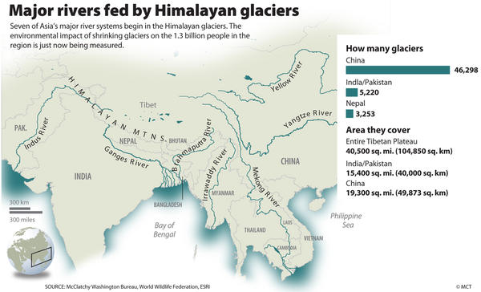
These glaciers serve as runoff water sources for many of the world’s largest rivers.

Slide 34
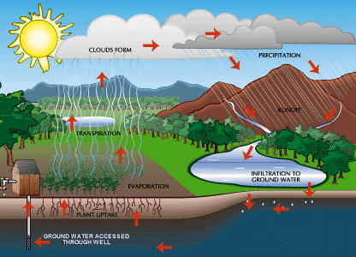
Effects on the Hydrologic Cycle
The hydrologic cycle describes the movement of water through evaporation, precipitation, runoff, and infiltration.
More heat in the atmosphere leads to…
A higher rate of evaporation (from land and sea both).
A greater capacity of the atmosphere for holding moisture.

Slide 35
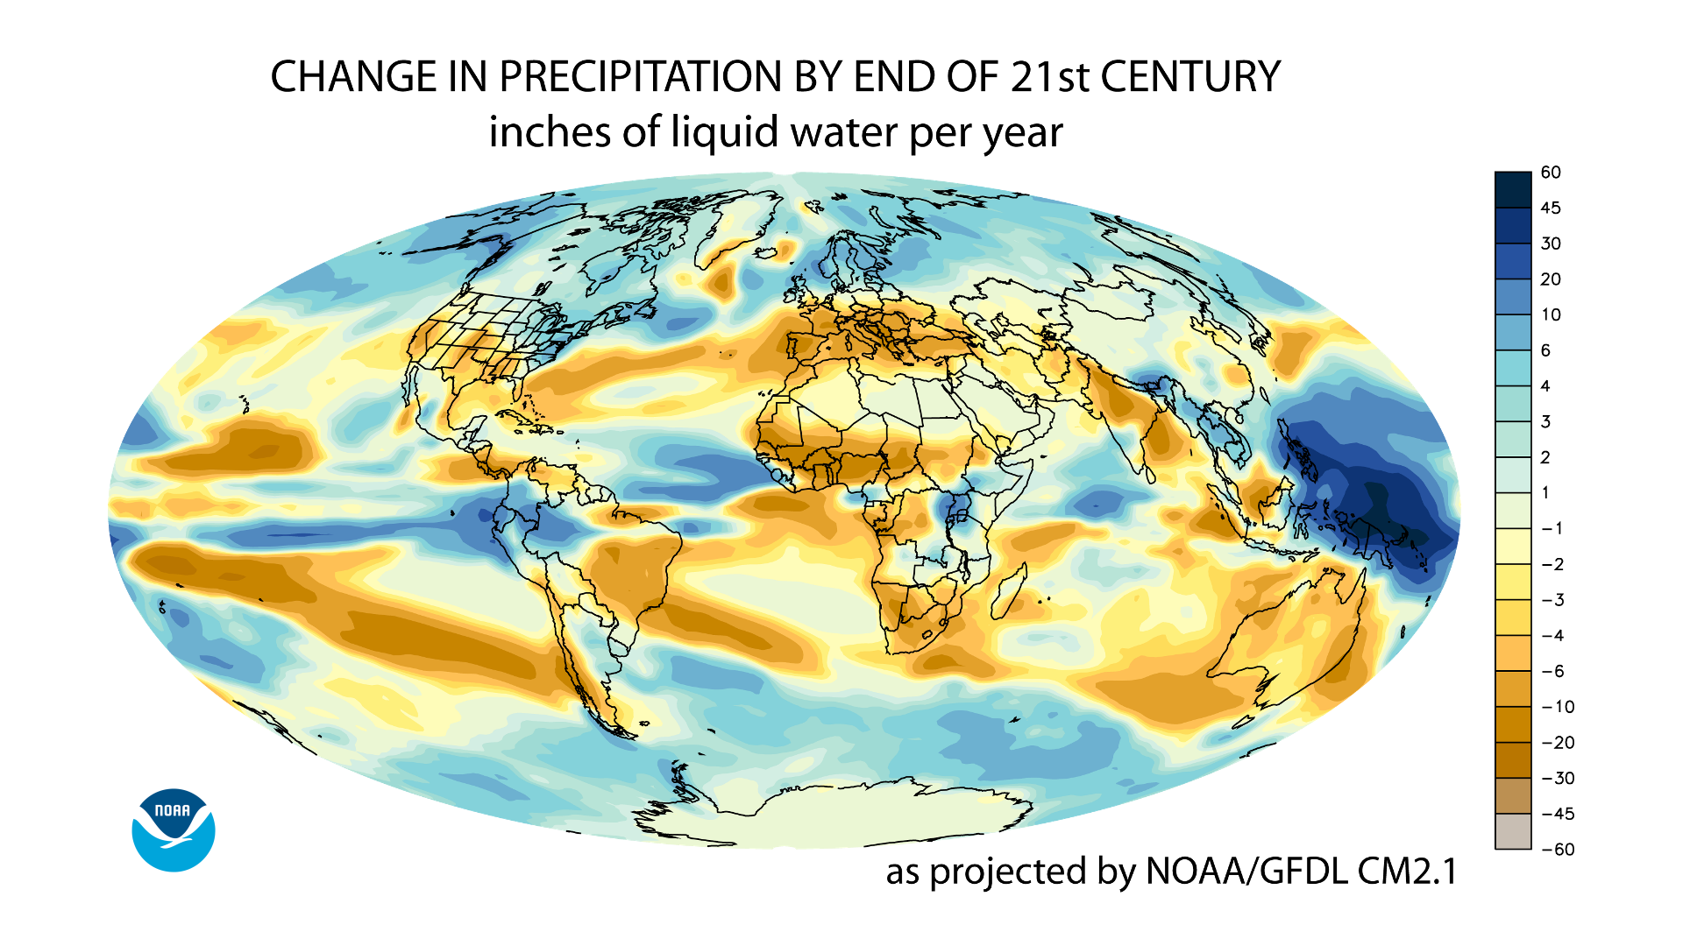
The combination of increased evaporation and atmospheric moisture content has the paradoxical effect of increasing the rate of both drought and flooding events.

Slide 36
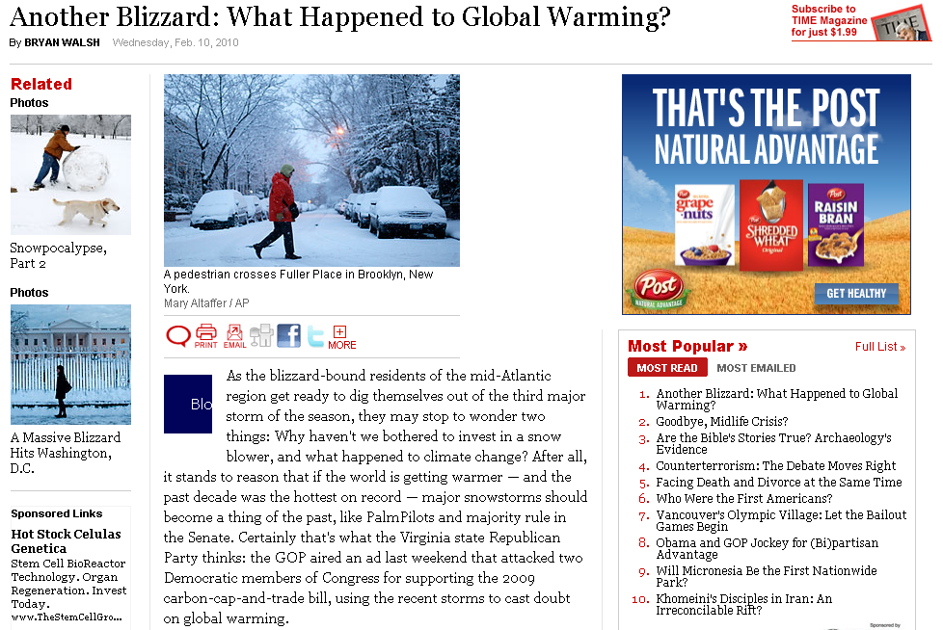

Slide 37
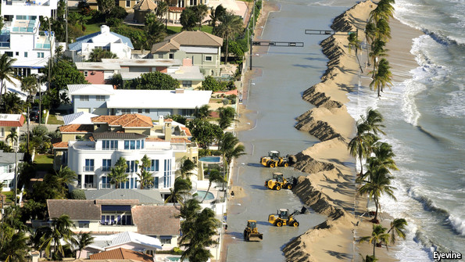
Sea Level Rise
As the ocean level rises, it will impact coastal cities.
Half of the surrounding area of Miami, for example, is only 5 feet above sea level.
Sand on highway A1A swept over a sea wall in Ft. Lauderdale, Florida by Hurricane Sandy in 2012.

Slide 38
An Inconvenient Truth, 2006.

Slide 39
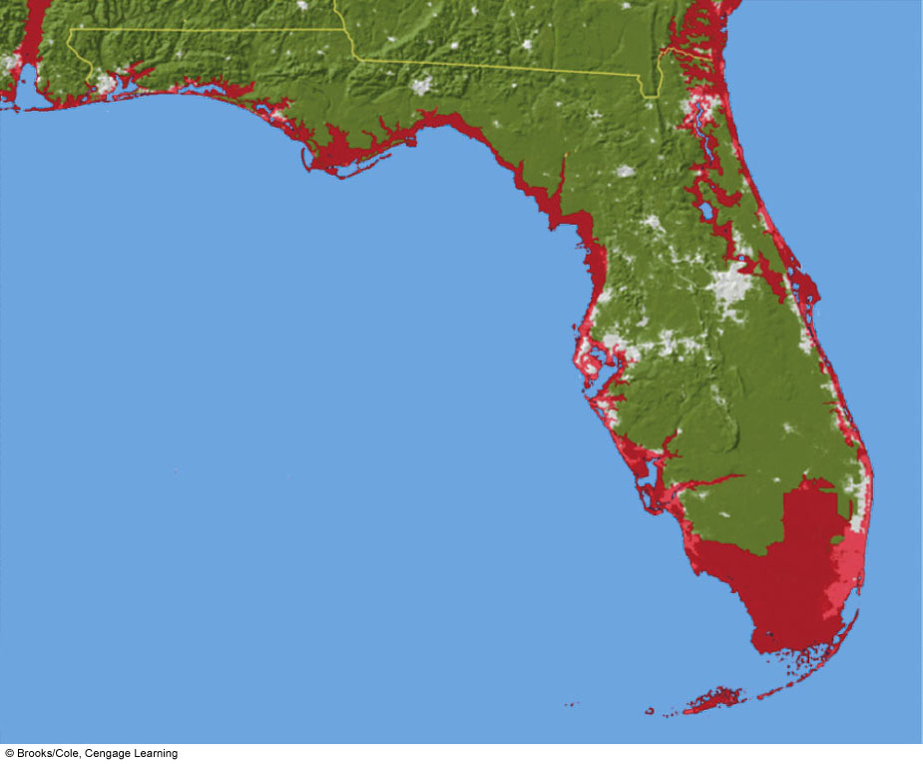
Pensacola
Tallahasee
Jacksonville
Atlantic Ocean
Orlando
Gulf of Mexico
Tampa
FLORIDA
Fort Meyers
Naples
Miami
Key West
Fig. 19-8, p. 509
Notes:
Figure 19.8
Areas of the U.S. state of Florida that will be flooded (red) if the average sea level rises by 1 meter (3.2 feet). (Data from Jonathan Overpeck and Jeremy Weiss based on U.S. Geological Service Data)

Slide 40
Did We Cause It?
The following passage is included in the IPCC Fifth Report:
“It is extremely likely that human activities have caused more than half of the observed increase in global average surface temperature since the 1950s.”
The evidence for this is found within the different isotopes of one of the atoms released by burning fossil fuels, carbon.

Slide 41
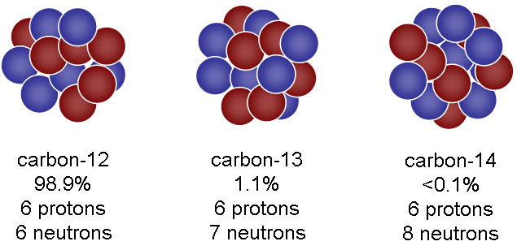
Plants have a preference for absorbing the lighter isotope (carbon-12) while performing photosynthesis.
Fossil fuels have similar ratios since they are derived from plants or algae.
13C / 12C ratios began shrinking around the beginning of the industrial revolution.
No other point in the data record shows ratios similar to what is currently in the atmosphere.
This points to human created, or anthropogenic greenhouse gas emissions, as a major contributor to global warming.

Slide 42
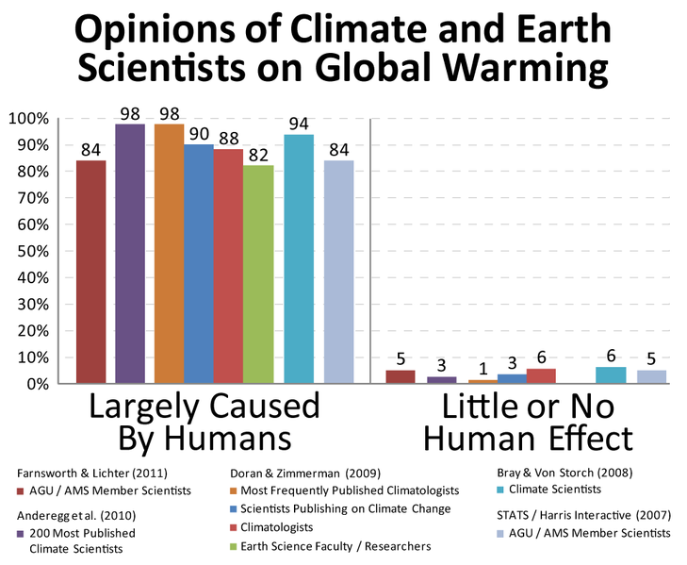
Scientific Consensus?
A survey was taken in 2004 of 928 abstracts of peer-reviewed papers relating to climate change.
None disagreed with the IPCC conclusions.
A different survey was taken in 2009 of 3,146 Earth Scientists (defined as publishing more than half of their peer-reviewed papers on climate change)
97% agree with the IPCC conclusions.

Slide 43
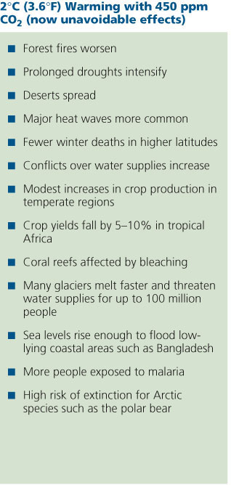
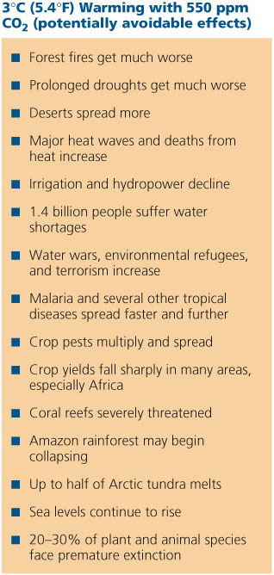
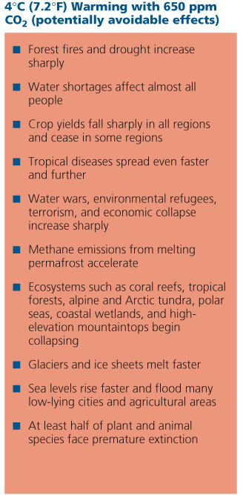
Projected Effects of Global Warming and Resulting Changes in Global Climate
Stepped Art
Fig. 19-7, p. 507
Notes:
Figure 19.7
Some projected effects of global warming and the resulting changes in global climate, based on the extent of warming and the total atmospheric concentrations of greenhouse gases in parts per million. According to the IPCC, a warming of 2 C° (3.6 F°) over 2005 levels is unavoidable, and an increase of at least 3 C° (5.4 F°) is likely sometime during this century (Figure 19-B). (Data from 2007 Intergovernmental Panel on Climate Change Report and Nicolas Stern, The Economics of Climate Change: The Stern Report, Cambridge University Press, 2006)

Slide 44
Solutions
In the long-term, the least expensive solutions involve the prevention of greenhouse gas emissions.
Decreasing fossil fuel consumption.
Improve energy efficiency.
Reduce deforestation.
Reduce agricultural practices known to release greenhouse gases.

Slide 45
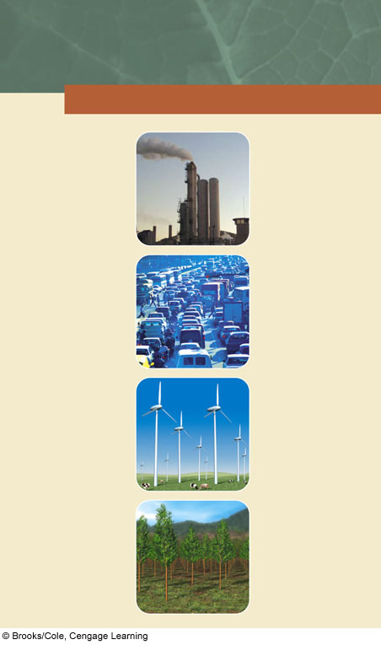
SOLUTIONS
Global Warming
Prevention
Cleanup
Cut fossil fuel use (especially coal)
Remove CO₂ from smokestack and vehicle emissions
Shift from coal to natural gas
Store (sequester) CO₂ by planting trees
Improve energy efficiency
Sequester CO₂ deep underground (with no leaks allowed)
Shift to renewable energy resources
Transfer energy efficiency and renewable energy technologies to developing countries
Sequester CO₂ in soil by using no-till cultivation and taking cropland out of production
Reduce deforestation
Sequester CO₂ in the deep ocean (with no leaks allowed)
Use more sustainable agriculture and forestry
Repair leaky natural gas pipelines and facilities
Limit urban sprawl
Reduce poverty
Use animal feeds that reduce CH₄ emissions from cows (belching)
Slow population growth
Fig. 19-13, p. 515
Notes:
Figure 19.13
Methods for slowing atmospheric warming and the resulting climate change during this century (Concept 19-3A). Question: Which five of these solutions do you think are the most important? Why?

Slide 46
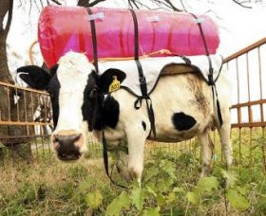
Both animal and plant agriculture have major impacts on global warming.
Deforestation leads to carbon dioxide release.
Flooding of rice fields leads to methane production and release by bacteria.
Cattle release large amounts of methane through their digestive processes.
35-40% of total global methane release!
Nitrous oxide is released by fertilizer application.
A gas-catching backpack used by researchers measured 800-1000L of emissions from an average cow per day.

Slide 47
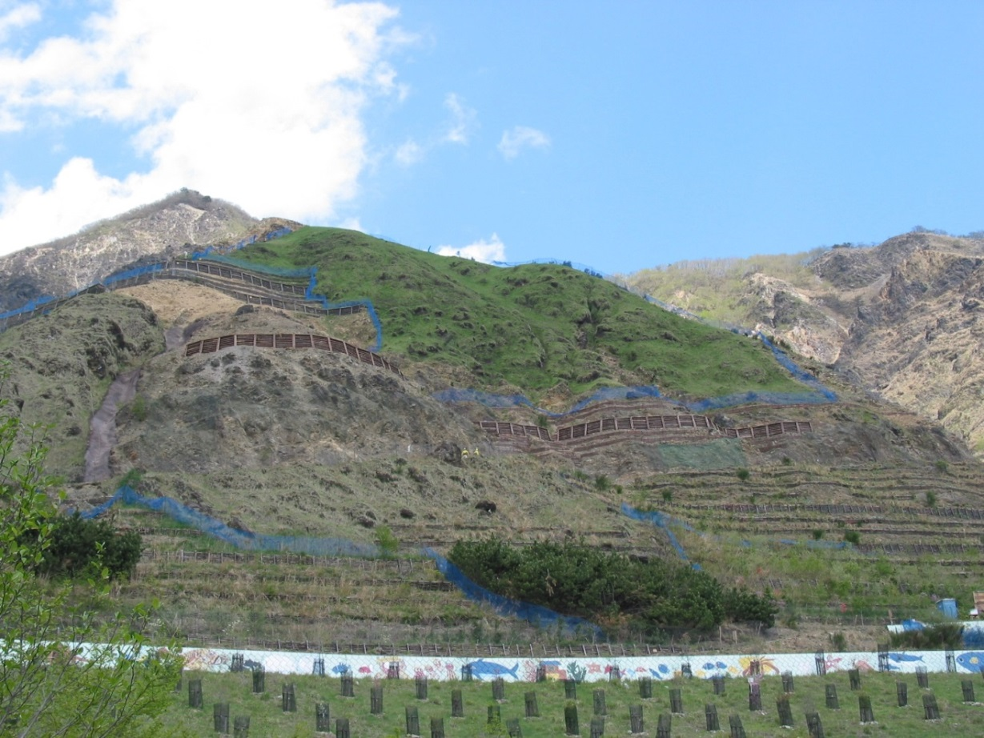
Carbon sequestration is the removal and storing of carbon dioxide from the atmosphere.
Sequestration can be accomplished biologically, through the use of living organisms.
Iron fertilization of the ocean, which would encourage algae growth.
Restoring bogs, forest, and wetlands can store carbon.
Experimental reforestation of the Ashio copper mine, Japan. Photo by Robert Stolz, japanfocus.org

Slide 48
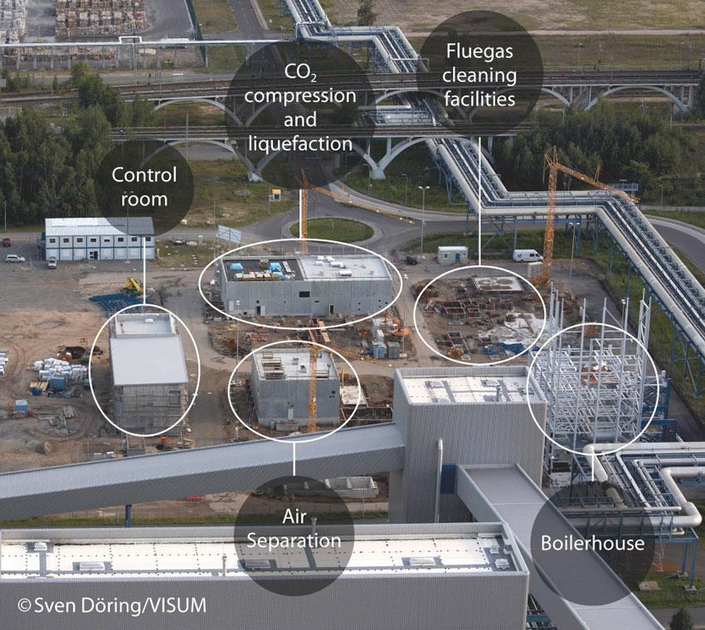
Carbon capture and storage is the process of capturing carbon dioxide produced from large point sources, such as coal-burning power plants and depositing it underground.
This significantly increases the cost of electricity.
Schwarze Pumpe power station and carbon capture facility, Spremburg, Germany.

Slide 49
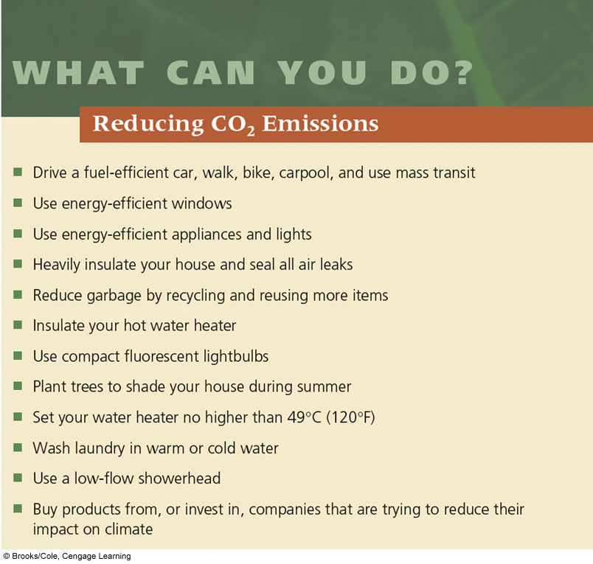
What Can You Do? Reducing CO₂ Emissions

Slide 50
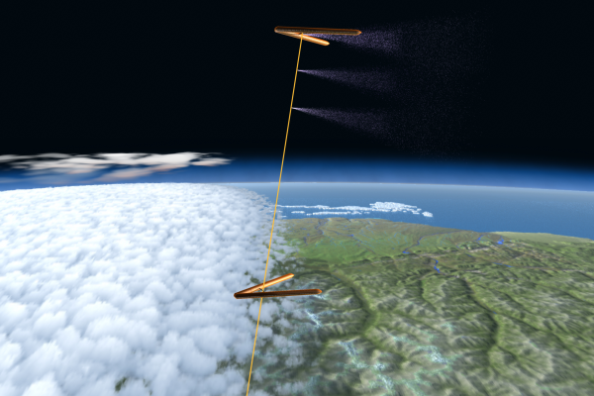
Geoengineering
Geoengineering is the study of intentionally and artificially changing natural processes of the Earth.
One idea is to combat warming by blocking some of the sunlight entering the Earth’s atmosphere.
Inject sulfur dioxide or particulate pollutants into the stratosphere.
This would block out just enough sunlight to bring global temperatures down to acceptable ranges.
The Stratoshield, a sulfate-releasing device concept developed by Intellectual Ventures Lab.

Slide 51
Legislation
In 2009, the U.S. House of Representatives voted in favor of a carbon dioxide emissions trading bill.
A cap would be set on the maximum amount of carbon pollution that can be produced by a single facility.
Additional credits would have to be purchased from other companies to offset the excess carbon production.
This would increase the cost of electricity from polluting fuels like coal.
Creates an economic incentive to move to natural gas, nuclear, or renewable sources.
The bill was defeated in the Senate.

Slide 52
The EPA, starting in 2013, began publishing restrictions on carbon pollution that can be released from power plants.
The agency is using authority granted by the Clean Air Act to treat carbon dioxide as a pollutant.

Slide 53
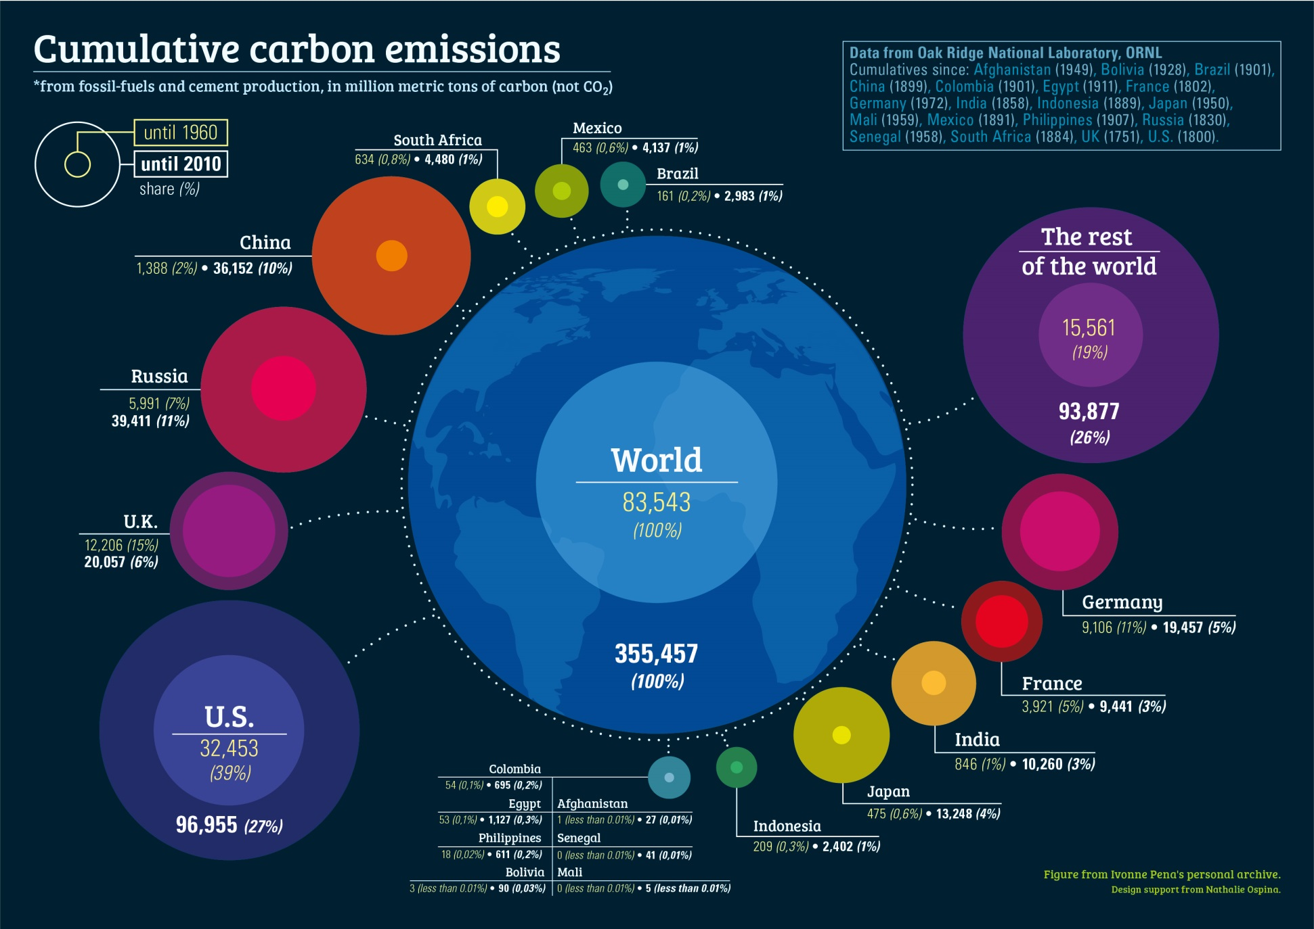
Carbon dioxide emissions are expected to continue to grow, especially with the industrialization of China and India.

Slide 54
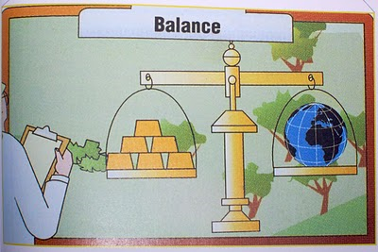
The main conflict with this issue is between short-term economic gains and long-term environmental consequences.
Image from An Inconvenient Truth book, by Al Gore.

