Slide 1
TIPS FRQ on APES Exam

Slide 2
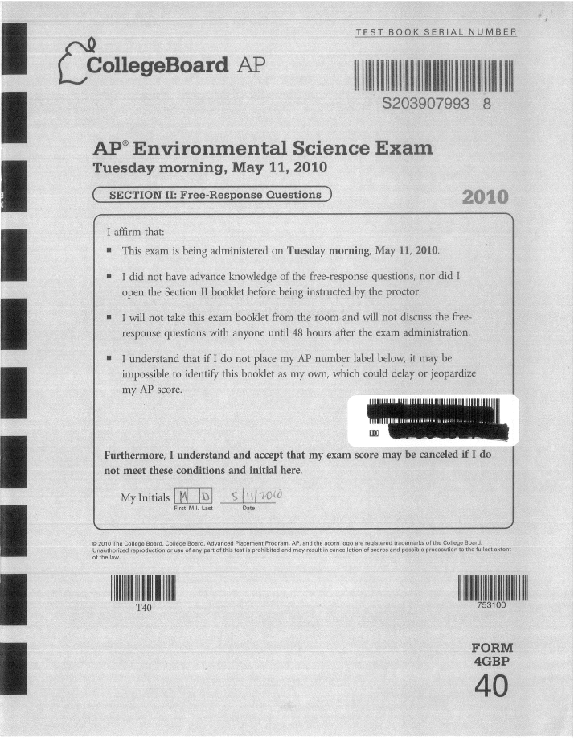
The APES Exam
Multiple Choice Section
100 Questions
90 minutes
Free Response Section
4 Questions
1 Document-Based Question
1 Data-Set Question
2 Synthesis/Evaluation Questions
90 minutes

Slide 3
Types of Free Response Questions
Types of Questions
Document Based (DBQ)
Data Set (Math)
Synthesis & Evaluation
One Document-Based Question
One Data-Set Question
Two Synthesis & Evaluation Questions

Slide 4
Document-Based Question
One question that is prompted with some type of document that will pertain to the questions being asked.
The document is primarily used to introduce the question, and although numbers or information provided in the document will help answer the question, students should not expect to pull their answers directly from the passage.
The purpose of the document is to introduce the question or questions. Students are expected to demonstrate comprehension by adding information learned from readings or class.
A common mistake that students make is to simply repeat information given in the document as their answer.

Slide 5
Data-Set Question
One question that is often referred to as the “math question” will include a graph, diagram, table, chart, or statistics.
Approximately 50% of the points on this type of question are earned by performing arithmetic calculations.
Students must show all work for all calculations and include the appropriate units with each number.
Students who do not feel that they can do the math part of the question should not give up! Read the remaining sections of the question and answer the portions that do not require calculations.
Calculators are not permitted on the APES exam so students must be comfortable using basic algebra and multiplying and dividing exponents and scientific notation.

Slide 6
Synthesis & Evaluation Questions
There are two Synthesis & Evaluation questions on the free-response section of the AP Environmental Science exam.
It may be easiest to understand what a Synthesis & Evaluation question is by understanding what it is not. If a question is not a math question or DBQ, it is a Synthesis & Evaluation question.
A Synthesis & Evaluation question will require students to write an essay in which they demonstrate knowledge about one of the topics of study in the AP Environmental Science course.
In rare cases, a simple calculation may be required in a Synthesis & Evaluation question; however the calculation will likely be worth only one or two points.

Slide 7
Free Response Tips
Identify or List
These terms are asking students for a specific object, advantage, disadvantage, cause, solution, etc. Students are required to write in prose (complete sentences) even if it may seem like they can answer this type of question in one word. They must write the answer in a complete sentence to receive credit.
For example, if a question states, “Identify two uses of fuelwood in developing countries.” The answer can be as short as, “Two uses of fuelwood in developing countries are for heating and cooking.” However, you would earn no points for simply writing “heating and cooking.”

Slide 8
More Free Response Tips
Describe or Explain
These terms are asking for details beyond just identifying an object or solution. Often these terms are used with the exact number of solutions or objects to be described. A good description will usually take more than one sentence.
For example, a question may state “Describe TWO benefits of using fuelwood.” A good response to this prompt is, “Two benefits of the use of fuelwood are the ability for people to heat their homes without using fossil fuels which are non-renewable and result in habitat loss during their extraction. If managed sustainably, the use of fuelwood can minimize habitat loss and is considered a renewable resource.”

Slide 9
More Free Response Tips
Discuss
Often, 2–3 points may be earned for this type of question; therefore, it is important to write additional detail and go beyond a simple description or explanation. A good discussion may take an entire paragraph.
For example, a question states, “Discuss a benefit to using fuelwood over current conventional fossil fuels.” A good response to this prompt is, “A benefit of using fuelwood over a conventional fossil fuel like coal is the reduction in sulfur dioxide emissions associated with coal burning practices. By decreasing sulfur dioxide emissions we also reduce acid deposition problems that cause tissue damage to trees in terrestrial ecosystems and cause fish kills due to lower pH in aquatic systems.”
Remember, discussion questions require students to not only identify and define but to further elaborate.

Slide 10
More Free Response Tips
Write an Argument
An argument is a series of statements all in support of a stated position on an issue. As a result, students may be rewarded for writing a lengthy list. An argument is the most extensive and detailed response that students could be called upon to write and it should be at least one paragraph in length.
For example, a question states, “Write an argument in support of the practice of sustainably harvesting fuelwood.” A good response to this prompt is, “Harvesting fuelwood sustainably avoids using practices like clear-cutting forests. Clear-cutting causes soil erosion, and runoff into waterways causing sedimentation, which decreases primary productivity, increases fish kills due to suffocation, and results in poor water quality for people who depend on the waterways for their domestic water use. Furthermore, when the rate of tree harvesting exceeds the rate of replanting, tracts of forest that function as carbon dioxide reservoirs are no longer available, which will increase carbon dioxide levels in the atmosphere and further global climate change.”

Slide 11
More Free Response Tips
Read each question carefully. Consider the verb used (e.g., identify, discuss, explain). Take a few minutes to organize an answer before beginning to write.
Be time-conscious. There are approximately 22 minutes to answer each FRQ.
Be sure to show all work including units on all calculations.
Every APES student should be comfortable working with metric prefixes, decimals, percentages, fractions, algebra, exponents, and scientific notation.
A math-based free-response question always contains a part of the question that can be answered without completing the calculations.

Slide 12
More Free Response Tips
Write in prose. Always answer in complete sentences. All writing must be clear and large enough for the reader to easily read your answer. Outlines or bulleted lists are not acceptable.
Do not restate the question—it is a waste of time. Essays also do not need an introduction and/or conclusion. The reader is simply looking for correct statements that demonstrate knowledge of the concept.
Avoid examples or solutions that are specific to your local region or obscure. Answers on the rubric for the free-response section must be applicable to every exam taken anywhere in the world. Use commonly known examples or solutions.
Avoid fabricating information. It is a waste of time.

Slide 13
More Free Response Tips
When a mistake is made, avoid wasting time and losing momentum on a question by stopping to obliterate work—strike out the mistake and keep moving forward.
Label answer parts (e.g., a, b, c, i, ii). This will help ensure that the entire question has been answered and makes it easier to move on or come back as needed.
Do not write long lists in an answer! If the question says “Identify TWO” then identify only two items. The graders are instructed to grade only the first two items even if a student writes a longer list. Thus, if two items are requested, and a student lists six items of which the first two are incorrect, no points will be given even if the last four of the six answers were correct.

Slide 14
More Free Response Tips
Read the question carefully. Students may be prompted to describe an environmental problem in one part of a question, an economic problem in another, and an environmental benefit in a third. Underline or circle the key terms “environmental” and “economic,” and be certain to provide an appropriate response.
A good rule of thumb is to read “environmental” as “ecological” and to write about how the topic being addressed in the question effects the abundance, diversity, or distribution of life.
Follow through with a full explanation of scientific terms. Many students fail to get points because they didn’t finish a thought. An easy way to accomplish this is to define the scientific terms used in the essay, and, if possible, provide an example to illustrate.

Slide 15
More Free Response Tips
Do not use clichés for answers and avoid rhetorical questions (e.g., “there is no away in pollution”; “not in my backyard”; “ where are the animals supposed to go?”). Instead students must scientifically explain answers to earn points.
Be concise—do not tell the reader everything about a topic. Only answer what is asked for to avoid wasting time.
Answer the question that you were asked…not just any question to which you happen to know the answer. Sometimes, in an effort to fill space, students will launch into a dissertation that is not relevant to the question that was asked. Only answer what is asked for to avoid wasting valuable time.

